Slide 1
NEONATAL RESUSCITATION
Dr Y Prinsloo

Slide 3
KEY CONCEPT
EFFECTIVE VENTILATION OF THE BABY’S LUNGS

Slide 4
Neonatal Resuscitation
Rarely resuscitation needed
10 % require HELP WITH TRANSITION TO EXTRA-UTERINE LIFE
Only 1% require extensive resuscitation
Prematurity and PERINATAL HYPOXIA are the leading cause of death in newborns

Slide 5
TRANSITION TO EXTRA-UTERINE LIFE

Slide 6
TRANSITION TO EXTRA-UTERINE LIFE

Slide 7
Transition to EXTRA-UTERINE LIFE
High pulmonary
vascular resistance
Low systemic
vascular resistance
Low systemic
blood pressure

Slide 8
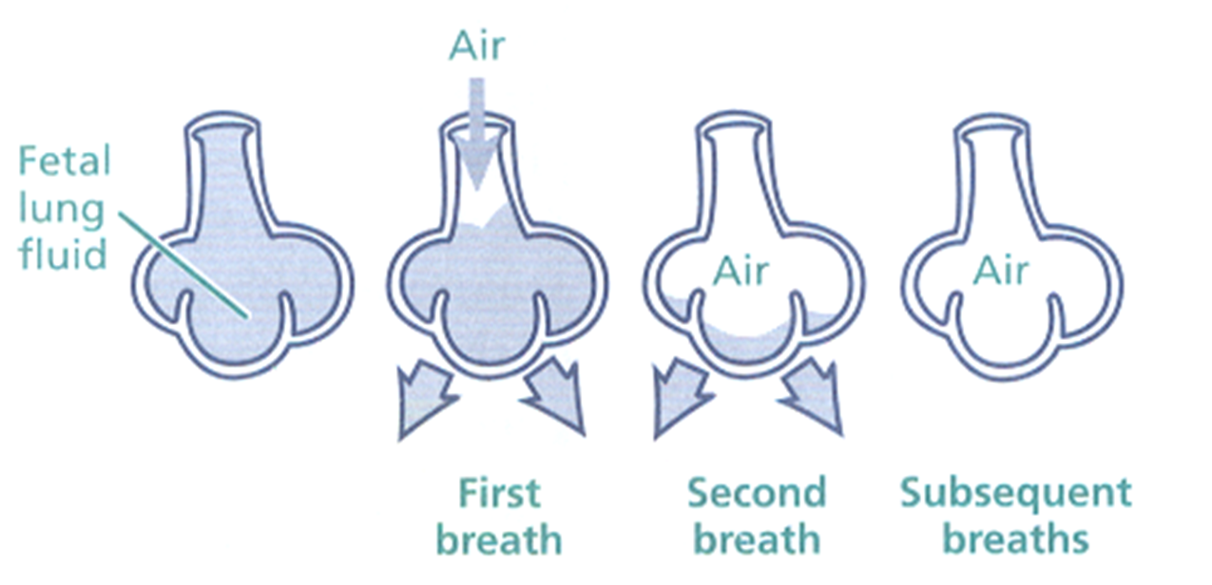
TRANSITION TO EXTRA-UTERINE LIFE
VENTILATION OF LUNGS IS VITAL

Slide 9
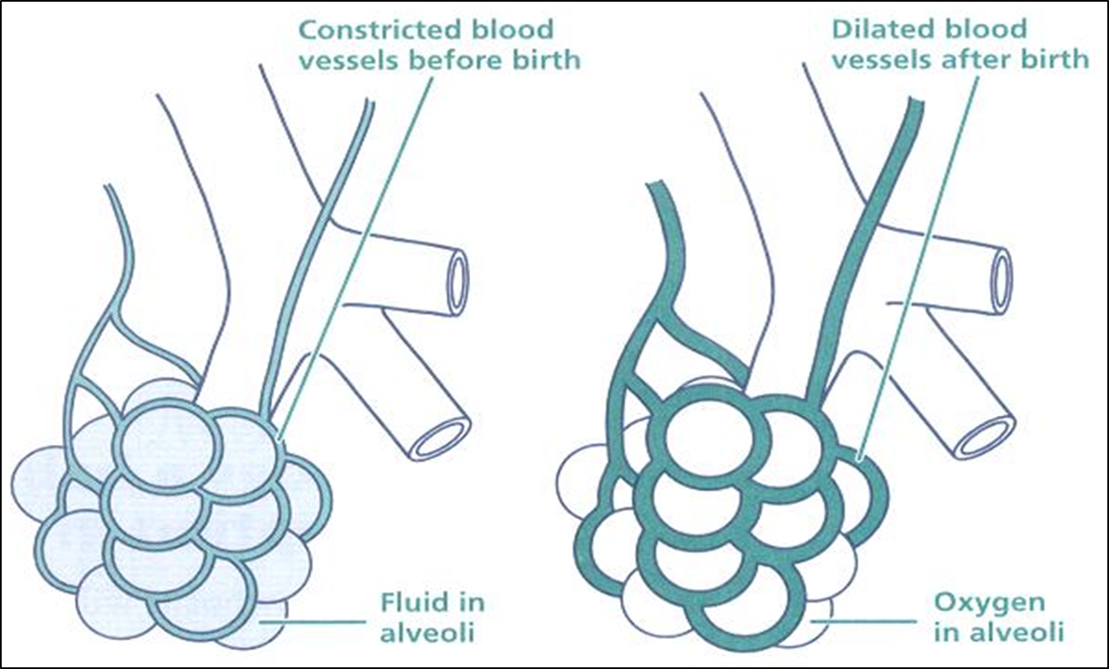
TRANSITION TO EXTRA-UTERINE
VENTILATION OF LUNGS IS VITAL!

Slide 10
TRANSITION to EXTRA-UTERINE LIFE
Cord is clamped:
Increased systemic blood pressure
Lungs are ventilated:
Decreased pulmonary vascular resistance
Increased blood flow to lungs
Reversal of right to left shunt and duct gradually closes
Oxygenation of blood in lungs

Slide 11
COMPROMISED TRANSITION
LUNGS NOT VENTILATED/AIRATED:
Lack of respiratory effort (central/drugs/asphyxiated)
Obstruction to air flow (secretions/meconium/anatomical)
Poor lung function (HMD/Hypoplasia)
Persistent pulmonary hypertension
Cardiac abnormalities
KEY MESSAGE: VENTILATION OF THE LUNGS!

Slide 12
FETAL DISTRESS / FLAT NEWBORN
Meconium is aspirated in-utero
ONLY PRIMARY apnoea will respond to STIMULATION
GASPING is treated as APNOEA

Slide 13
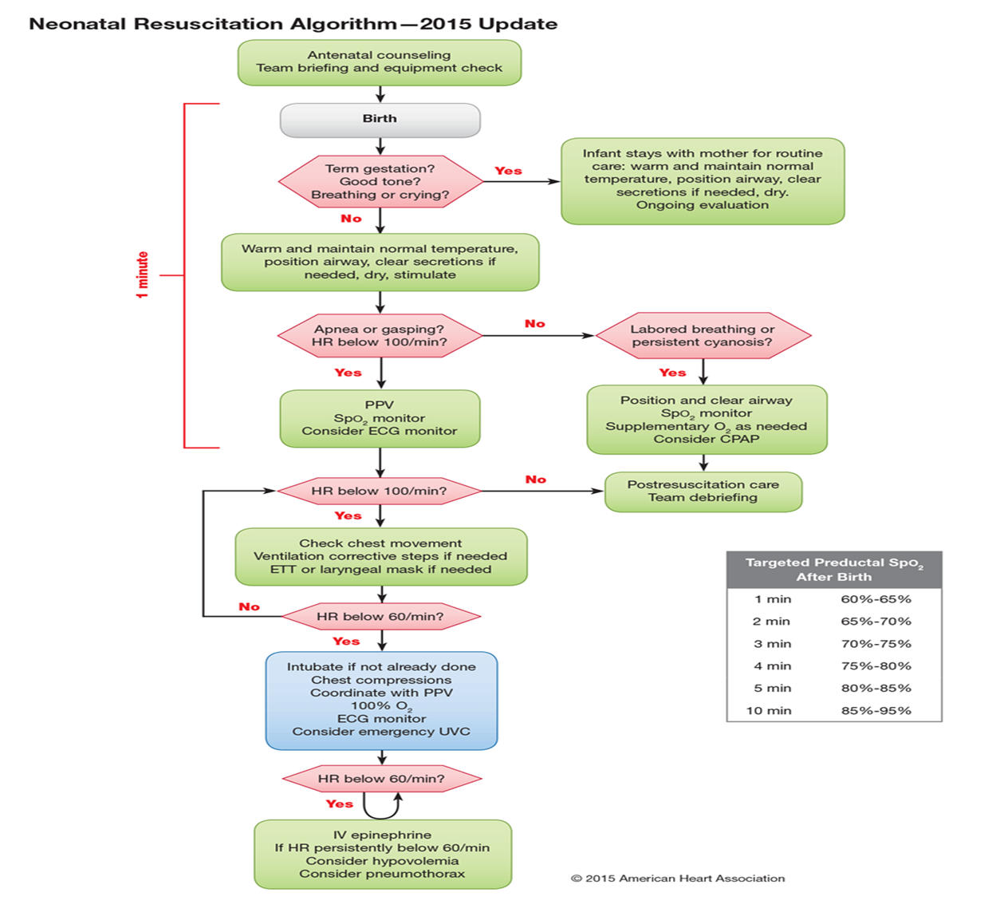
RESUSCITATION ALGORITHM

Slide 15
ANTENATAL COUNSELLING/TEAM Briefing equipment check/preparation
Assess perinatal risk (Not always predicatable)
Gestation?
How many babies?
Fluid clear
Additional risk factors
Prepare for delivery
Assemle team, identifies leader, delegates tasks
Equipment check

Slide 16
PERINATAL RISK FACTORS

Slide 17
EQUIPMENT CHECK and SETUP
INITIAL STEPS
Timer
Preheat warmer and dry towels
Plastic bag
Transport Incubator warmed
8F / 10F suction catheter
Connect and set to 80-100 mm Hg
EVALUATE
Stethoscope
Pulse oximeter / ECG monitor
VENTILATE/OXYGENATE
Masks and oxygen tubing
Neopuff and Ambubag - checked
Gas flow to 5 – 10 L/min
Blender to 21-100%
8F feeding tube
20 ml syringe
INTUBATE
Laryngoscope X 2 (working)
Blades 00, 0, 1 (working)
ET tubes (2.5, 3.0, 3.5, 4.0)
LMA size 1 with 5 ml syringe
Strapping and scissors
Meconium aspirator
MEDICATE
Adrenaline diluted to 1:10 000
Normal saline / Blood / Glucose
Umbilical vein catheter and drip supplies
OTHER
Documentation paper
Personal protective gear

Slide 18
Equipment check and setup
UVC EQUIPMENT
Sterile gloves
Antiseptic solution and swabs
Sterile drapes
Scalpel / scissors - sterile
Umbilical tape
Forceps
Umbilical catheters (3.5F, 5F) (FEEDING TUBE)
Three-way stopcock (Optional)
Needles / syringes
Securing tape / opsite

Slide 19
ALWAYS CHECK AMBUBAG

Slide 20
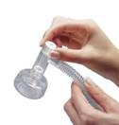
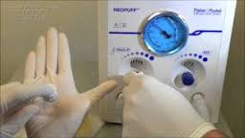
SETUP NEOPUFF PRIOR TO DELIVERY

Slide 22
3 QUESTIONS ONCE DELIVERED
TERM?
TONE?
BREATHING/CRYING?
DELAYED cord clamping if BREATHING or crying (30 – 60 sec)
REMEMBER TO START THE CLOCK!

Slide 24
ROUTINE CARE
Stay with mom
Dried, airway positioned and cleared prn
Skin to skin and covered
Observe and document apgar scores
Monitor breathing
NB MAINTAIN NORMAL TEMPERATURE and INITIATE BREASTFEEDING

Slide 26
INITIAL STEPS ONLY 30 Seconds
Move to radiant heater (no delayed cord clamping)
START THE TIMER +- CALL FOR HELP
Maintain normal temperature
Position airway (blanket under shoulders)
Clear airway ONLY IF NEEDED and GENTLY
Copious / obstruction
Mouth before nose
Dry and stimulate (DO NOT WASTE TIME)
DO NOT DRY if < 32 weeks or < 1000g
Put into plastic bag

Slide 27
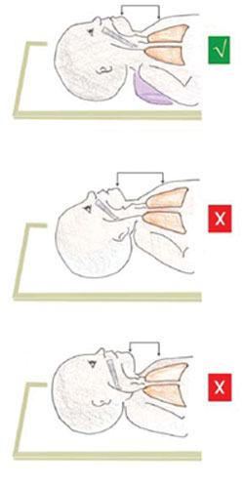
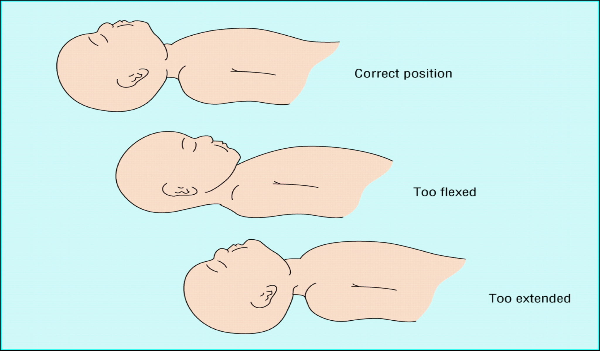

Slide 28
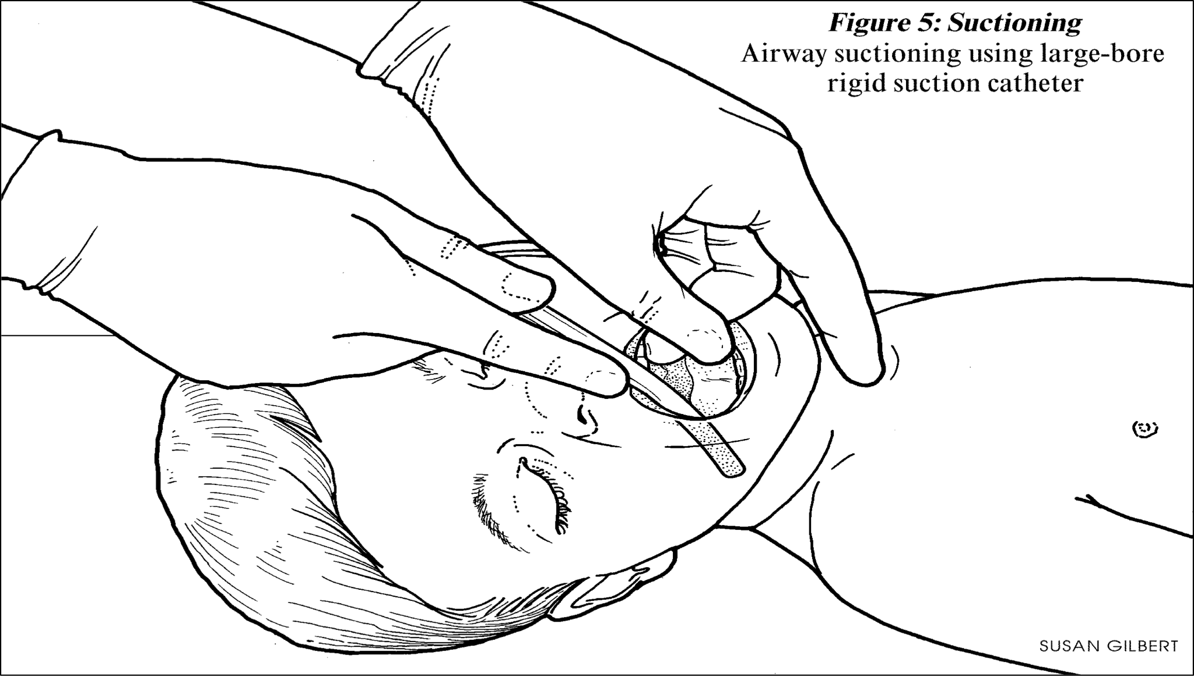

Slide 29
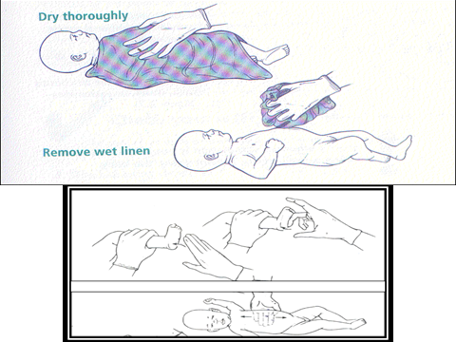

Slide 31
EVALUATE
BREATHING? – If not start IPPV IMMEDIATELY
Look
Apnoea?
Gasping?
Laboured breathing?
PULSE?
Stethoscope
Pulse oximeter
Palpation at base of cord
ECG as gold standard
Less or more than 100?

Slide 33
Laboured breathing or Cyanosis
Pulse > 100 and breathing
BUT: Laboured breathing or cyanotic
WHAT TO DO:
Position and clear airway
Sats monitor
Supplemental oxygen as guided by preductal sats
CPAP strongly considered

Slide 34
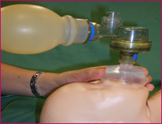
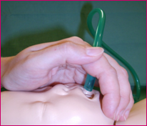
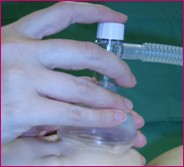
Supplemental Oxygen
ACCORDING TO PREDUCTAL SATS (start with 21-30%)

Slide 35
cpap
Notes:
Demonstrate mask to secure cpap with neopuff

Slide 37
START IPPV WITHIN 60 SeCONDS
Start IPPV if:
Pulse < 100 AND/OR
Apnoea / Gasping / Unsure if breathing
GOLDEN MINUTE
Initial steps
Evaluation
Starting IPPV
Sats probe once IPPV started
THE BABY MUST BREATH / BE VENTILATED WITHIN THE FIRST MINUTE OF LIFE!!

Slide 38
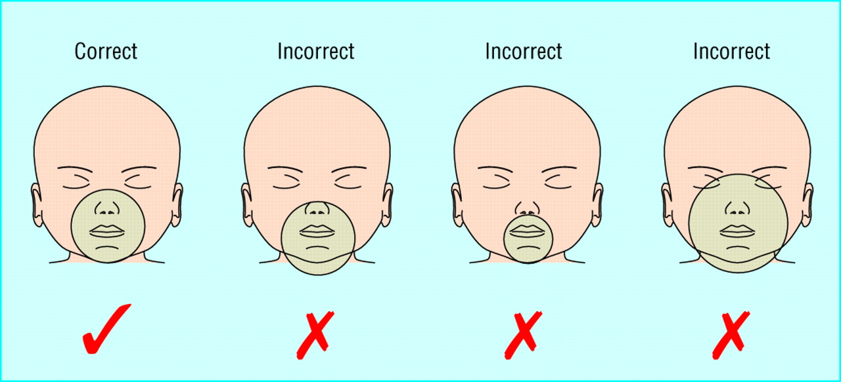
Notes:
40 to 60 breaths per minute

Slide 39
ENSURE CHEST RISE WITH EACH BREATH
TARGETED PREDUCTAL SATS
1 MIN | 60 – 65%
2 MIN | 65 – 70%
3 MIN | 70 – 75%
4 MIN | 75 – 80%
5 MIN | 80 – 85%
10 MIN | 85 – 95%
 | Term | Prem
Initial FiO2 | 21% | 30%
Initial PIP | 20 | 20
Initial PEEP | 2-5 cm H2O | 2 - 5 cm H2O
Rate | 40 - 60 | 40 - 60

Slide 40
ENSURE EFFECTIVE IPPV FOR 30 SEC
 | CORRECTIVE STEP | ACTION
M | Mask adjustment | Ensure good seal
R | Reposition airway | Sniffing position
S | Suction mouth and nose | Only if secretions
O | Open mouth | Ventilate with mouth slightly open
P | Pressure increase | Every few breaths
A | Airway alternative | ET tube or LMA
FEATURES OF EFFECTIVE IPPV
Increase in pulse rate
Chest movements
Increase in saturations
ASSESS PULSE WITHIN 15 SEC OF IPPV TO DETERMINE IF EFFECTIVE

Slide 41
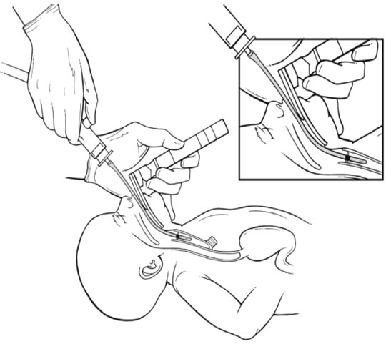
WHAT ABOUT MECONIUM?
No evidence for routine
intubation and suctioning
Initial steps (gently suction PRN)
Evaluate
Start IPPV if needed
MR SOPA
If still ineffective IPPV after ETT

Slide 42
EVALUATE AFTER 30 SEC of EFFECTIVE IPPV
PULSE
If <100 → Continue IPPV until breathing or on ventilator
If > 100 → Supplemental oxygen / CPAP IF breathing spontaneously and laboured
If < 60 → Intubate (if possible) and start chest compressions
BREATHING
Continue IPPV until breathing spontaneously AND pulse > 100
SATS
Targeted preductal sats

Slide 44
PULSE < 60 CHEST COMPRESSION
If Pulse < 60 after 30 sec of EFFECTIVE IPPV:
Intubate if not yet done
DO NOT WASTE TIME IF ABLE TO VENTILATE WELL!
Chest compressions : ventilations 3:1 (helper)
Increase FiO2 to 100%
Peripheral IVI access (helper)
Consider emergency UVC (helper)
Call for help of not yet
Re-evaluate after 60 seconds of CC

Slide 45
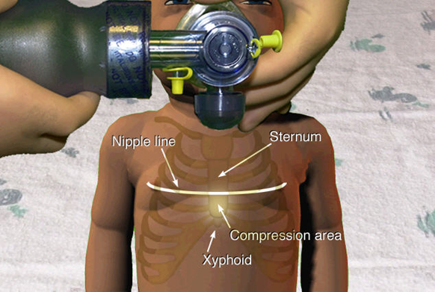
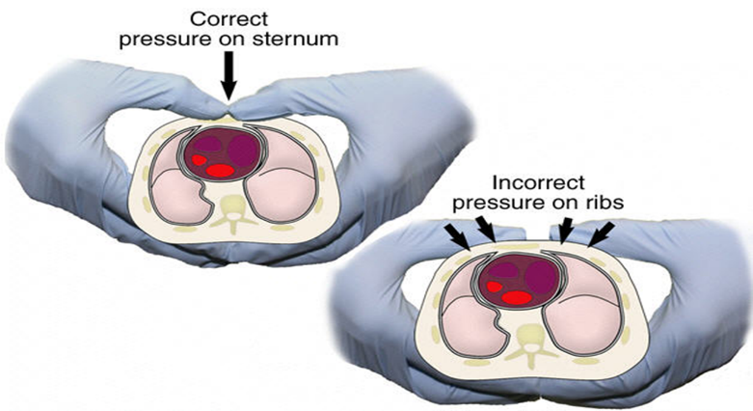
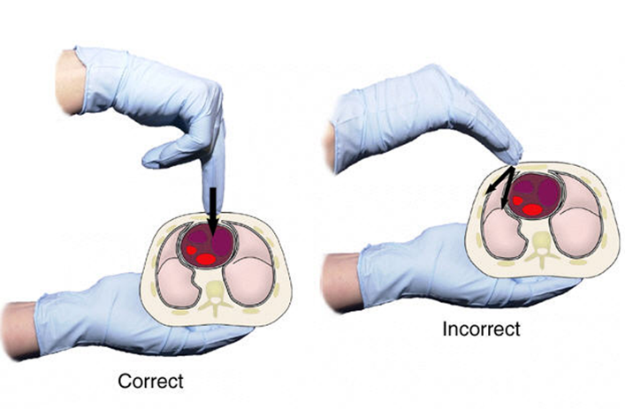
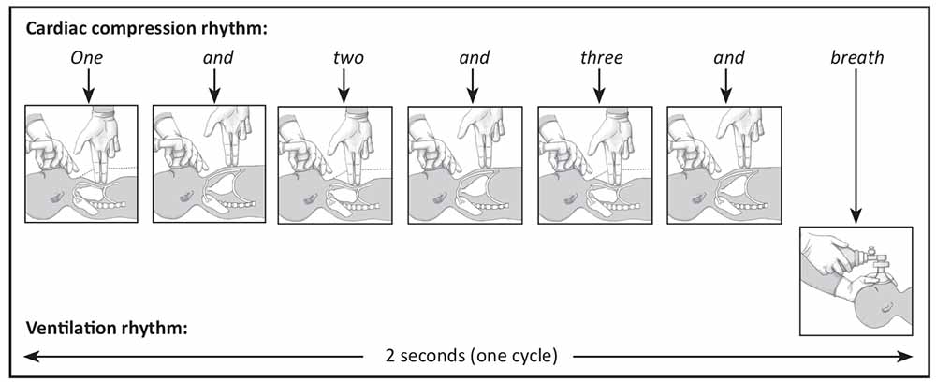
r
FINGERS TO MAINTAIN CONTACT
Easier if INTUBATED
1/3
3 : 1

Slide 46
INTUBATION

Slide 49
Re-evaluate every 60 sec of chest compressions
If Pulse > 60:
Stop chest compressions
Continue IPPV until pulse > 100 and spontaneous breathing
Titrate oxygen to targeted preductal sats
If Pulse < 60:
Continue coordinated chest compressions : ventilations
Give adrenaline (every 3 – 5 min)
Correct hypovolaemia only if present
Consider pneumothorax
Check glucose

Slide 51
Adrenaline
Notes:
After 30 sec of effective chest rising ventilations AND 60 seconds of coordinated 3:1 compressions:ventilations

Slide 52
Volume expansion

Slide 53
Consider pneumothorax
Decompress with catheter-over-needle device in 4th intercostal space MAL.

Slide 54
Check glucose
If < 2.6
2ml/kg of 10% NNL / 10% dextros IVI over 2-3 min
NB: Check glucose in all:
Babies who required resuscitation
Babies not starting to breath spontaneously
IUGR / Prem
IDM

Slide 55
What about naloxone?
NOT INDICATED IN RESUSCITATION
RISK OF MIOCARDIAL DAMAGE!

Slide 56
Discontinuing resuscitation
Individualise
Apgar score of 0 at 10 minutes is a strong predictor of mortality and morbidity in late prem and term infants.
Witholding – conditions ass with high mortality and poor outcome (gestation, birth weight, congenital anomalies)

Slide 57
POST RESUSCITATIVE CARE
Maintain normothermia
As per protocols therapeutic induced hypothermia
Prevent hypoglycaemia
Treat with 2ml/kg 10% dextrose
Prevent with starting maintenance 10% NNL asap
Maintain sats 90 – 95%
Consider CPAP and surfactant
Consider transfer

Slide 58
KEY POINTERS
Delayed cord clamping
Golden 60 seconds
Record temperature (predictor of outcome)
Maintain temperature 36.5˚C – 37.5˚C
Induced therapeutic hypothermia if mod-severe HIE > 36 weeks as per clearly defined protocols
No routine intubation and tracheal suctioning for meconium
30 Seconds of effective ventilation before assessing for chest compressions.
Start with FiO2 21-30% and increase to 100% once CPR.
Ambubag cannot be used for free flow oxygen or CPAP.
CALL FOR HELP!

